Slide 1
Propositional Equivalences
Course Code: CSC 1204
Course Title: Discrete Mathematics
Dept. of Computer Science
Faculty of Science and Technology
Lecture No: | 3 | Week No: | 2 | Semester: | Summer 2021-2022
Lecturer: | S.M. Abdur Rouf Bhuiyan [ arouf@aiub.edu]

Slide 2
Lecture Outline
1.2 Propositional Equivalences
Tautology
Contradiction
Contingency
Logical Equivalences

Slide 3
Objectives and Outcomes
Objectives: To understand the terms Tautology, Contradiction, Contingence with examples, to understand the standard logical equivalences, to determine whether a compound proposition is a Tautology or Contradiction, to determine whether two compound propositions are logically equivalent.
Outcomes: Students are expected to be able to write the definitions of Tautology, Contradiction and Contingency with examples, be able to determine whether a compound proposition is a Tautology or Contradiction using a Truth Table and standard logical equivalences, be able to determine whether two compound propositions are logically equivalent using a Truth Table and logical equivalences.

Slide 4
Tautology
Tautology: A compound proposition that is always true is called a tautology.
Examples:
p ∨ ¬p
b) The professor is either a woman or a man
c) People either like watching TV or they don’t

Slide 5
Contradiction
Contradiction: A compound proposition that is always false is called a contradiction.
Examples:
a) p ∧ ¬p
b) x is prime and x is an even integer greater than 8
c) All men are good and all men are bad

Slide 6
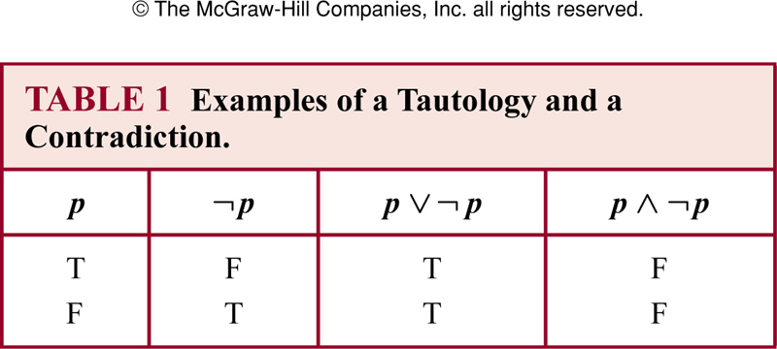
Examples of Tautology and Contradiction

Slide 7
Contingency
Contingency: A compound proposition that is neither a tautology nor a contradiction is called a contingency.
In other words, a compound proposition whose truth value is not constant is called a contingency.
Examples:
p → ¬p
b) P
c) ¬p

Slide 8
How to determine whether a compound proposition is a Tautology or Contradiction?
We can determine whether a compound proposition is a Tautology or Contradiction in two ways:
Using a truth table – The easiest way to see if a compound proposition is a tautology or contradiction is to use a truth table. Show that the compound proposition is always true
Using (Laws of) Logical Equivalences

Slide 9
Tautology : Example
Show that [¬p ∧(p ∨q )]→q is a tautology using a
Truth Table

Slide 10
Solution
p | q | ¬p | p ∨q | ¬p ∧(p ∨q ) | [¬p ∧(p ∨q )]→q
T | T
T | F
F | T
F | F

Slide 11
Solution
p | q | ¬p | p ∨ q | ¬p ∧(p ∨q ) | [¬p ∧(p ∨q )]→q
T | T | F
T | F | F
F | T | T
F | F | T

Slide 12
Solution
p | q | ¬p | p ∨q | ¬p ∧(p ∨q ) | [¬p ∧(p ∨q )]→q
T | T | F | T
T | F | F | T
F | T | T | T
F | F | T | F

Slide 13
Solution
p | q | ¬p | p ∨q | ¬p ∧(p ∨q ) | [¬p ∧(p ∨q )]→q
T | T | F | T | F
T | F | F | T | F
F | T | T | T | T
F | F | T | F | F

Slide 14
Solution
p | q | ¬p | p ∨q | ¬p ∧(p ∨q ) | [¬p ∧(p ∨q )]→q
T | T | F | T | F | T
T | F | F | T | F | T
F | T | T | T | T | T
F | F | T | F | F | T
Since the truth table shows all the true values of compound proposition
[¬p ∧(p ∨q )]→q are true(T), so it is a tautology.

Slide 15
Class Work
Determine whether ¬ (p ∧ q) ∨ p is a tautology or contradiction.
Determine whether p ∧ (q ∧¬p) is a tautology or contradiction.

Slide 16
Logical Equivalences
Compound propositions that have the same truth values in all possible cases are called logically equivalent.
Definition : Compound propositions p and q are logically equivalent if p ↔ q is a tautology (denoted by p ≡ q or p ⇔ q )
NOTE: We will use the notation: p ≡ q

Slide 17
How to determine whether two compound propositions are logically equivalent?
We can determine whether two compound propositions are logically equivalent in two ways:
Using a Truth Table
Using (laws of ) Logical Equivalences

Slide 18
Using a Truth Table to determine whether two compound propositions are logically equivalent
Two compound propositions are logically equivalent if they always have the same truth values in the corresponding rows.
Construct a truth table for the given two compound propositions [in one table]
If the truth values of both of the compound propositions are same in the corresponding rows, then they are logically equivalent.
If the true values of both of the compound propositions are different in one or more rows, then they are NOT logically equivalent.

Slide 19

Example 1
Show that p ↔ q is logically equivalent to (p → q) ∧ (q → p)
Since the truth values of both of the compound propositions are same in the corresponding rows, they are logically equivalent.

Slide 20
Class Work
Show that p ∨ (q ∧ r ) and (p ∨q ) ∧ (p ∨ r ) are logically equivalent

Slide 21
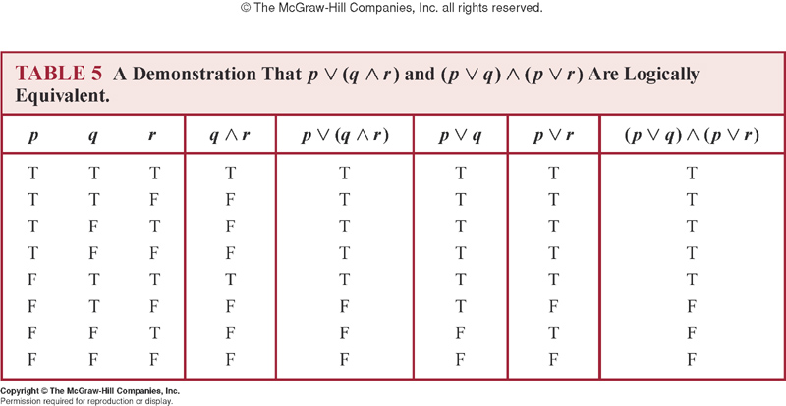
Solution
Since the truth values of both of the compound propositions are same in the corresponding rows, they are logically equivalent.

Slide 22
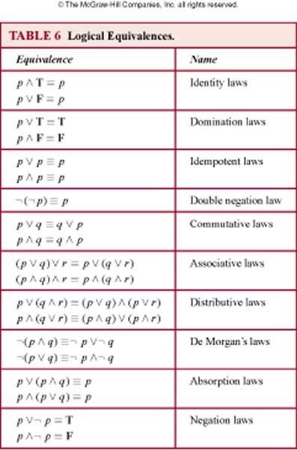
Logical Equivalences Table 6 ( page 24 ) ➔ Rosen, 7th edition

Slide 23
A very Useful Logical Equivalence(ULE)
p → q ≡ ¬p ∨ q

Slide 24
Example 1
Show that ¬(p → q) and p ∧ ¬ q are logically equivalent.
Solution:
by ULE

Slide 25
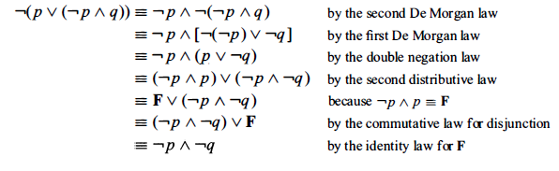
Example 7 (page 26)
Solution:

Slide 26
Exercise
Show that (¬p ∧(p ∨q ))→q is a tautology using a
series of logical equivalences.

Slide 27
Solution
(¬p ∧(p ∨q ))→q
≡ ( (¬p ∧p)∨(¬p ∧q) ) → q Distributive Law
≡ ( F ∨ (¬p ∧q))→q Negation Law
≡ (¬p ∧q )→q Identity Law
≡ ¬ (¬p ∧q ) ∨ q ULE
≡ (¬(¬p)∨ ¬q ) ∨ q De Morgan’s Law
≡ ( p ∨ ¬q ) ∨ q Double Negation Law
≡ p ∨ (¬q ∨q ) Associative Law
≡ p ∨ T Domination Law
≡ T So, (¬p ∧(p ∨q ))→q is a tautology.

Slide 28
Summary
What is Tautology and Contradiction? What is Contingency?
How to show/determine whether two compound propositions are logically equivalent?
Using a truth table
Using logical equivalences
How to show whether a compound proposition is a tautology?
Using a truth table
Using logical equivalences
Note: Make sure you learn the important Logical Equivalences in Table 6 (page 24) & ULE ( p → q ≡ ¬ p ∨ q )
Practice @ Home: Relevant Odd-numbered Exercises (e.g. 1, 3, 7, 9, 11, 15, 17 )

Slide 29
Practice @ Home
* Practice questions 1-4 without using a Truth Table
Determine whether (¬p ∧ (q →p)) → ¬q is tautology.
Determine whether (¬q ∧ (p →q)) → ¬p is tautology.
Show that (p ∧ (p → q)) → q is a tautology.
Show that ((p →q) ∧(p → r)) and (p → ( q ∧ r)) are logically equivalent.
** Practice relevant Odd-Numbered Exercises
==> 1, 3, 7, 9, 11, 15, 17

Slide 30
Answer 1
(¬p ∧ (q →p)) → ¬q
≡ (¬p ∧ (¬q ∨ p)) → ¬q [ULE]
≡ ((¬p ∧¬q) ∨ (¬p ∧ p)) → ¬q [Distributive Law]
≡ ((¬p ∧¬q) ∨ F) → ¬q [Negation Law]
≡ (¬p ∧ ¬q) → ¬q [Identity Law]
≡ ¬(¬p ∧ ¬q) ∨ ¬q [ULE]
≡ (p ∨ q) ∨ ¬q [De Morgan’s & Double Negation Law]
≡ p ∨ (q ∨ ¬q ) [Associative Law]
≡ p ∨ T [Negation Law]
T [Domination Law]
So, (¬p ∧ (q →p)) → ¬q is a tautology.

Slide 31
Answer 2
(¬q ∧ (p →q)) → ¬p
≡ (¬q ∧ (¬p ∨ q)) → ¬p [You MUST write the names of the laws]
≡ (¬q ∧¬p) ∨ (¬q ∧ q)) → ¬p
≡ (¬q ∧¬p) ∨ F → ¬p
≡ (¬q ∧¬p) → ¬p
≡ ¬ (¬q ∧¬p) ∨ ¬p
≡ q ∨ p ∨ ¬p
≡ q ∨ T
T
So, (¬q ∧ (p →q)) → ¬p is a tautology.

Slide 32
Answer 3
(p ∧ (p → q)) → q
≡ (p ∧ (¬p ∨ q)) → q
ULE (Substitution for → )
≡ ((p ∧ ¬p) ∨ (p ∧ q)) → q
Distributive Law
≡ ( F ∨ (p ∧ q)) → q
Negation Law
≡ (p ∧ q) → q
Identity Law
≡ ¬(p ∧ q) ∨ q
ULE (Substitution for → )
≡ (¬p ∨ ¬q) ∨ q
First De Morgan’s Law
≡ ¬p ∨ (¬q ∨ q )
Associative Law
≡ ¬p ∨ T
Negation Law
≡ T
Domination Law

Slide 33
Books
Discrete Mathematics and its applications with combinatorics and graph theory (7th edition) by Kenneth H. Rosen [Indian Adaptation by KAMALA KRITHIVASAN], published by McGraw-Hill

Slide 34
References
Discrete Mathematics, Richard Johnsonbaugh, Pearson education, Inc.
Discrete Mathematical Structures, Bernard Kolman, Robert C. Busby, Sharon Ross, Prentice-Hall, Inc.
SCHAUM’S outlines Discrete Mathematics(2nd edition), by Seymour Lipschutz, Marc Lipson

